Slide 1

Integrals Applied Electronics Part 3
RCET 0264 Introductory Calculus
Tim Leishman

Slide 2
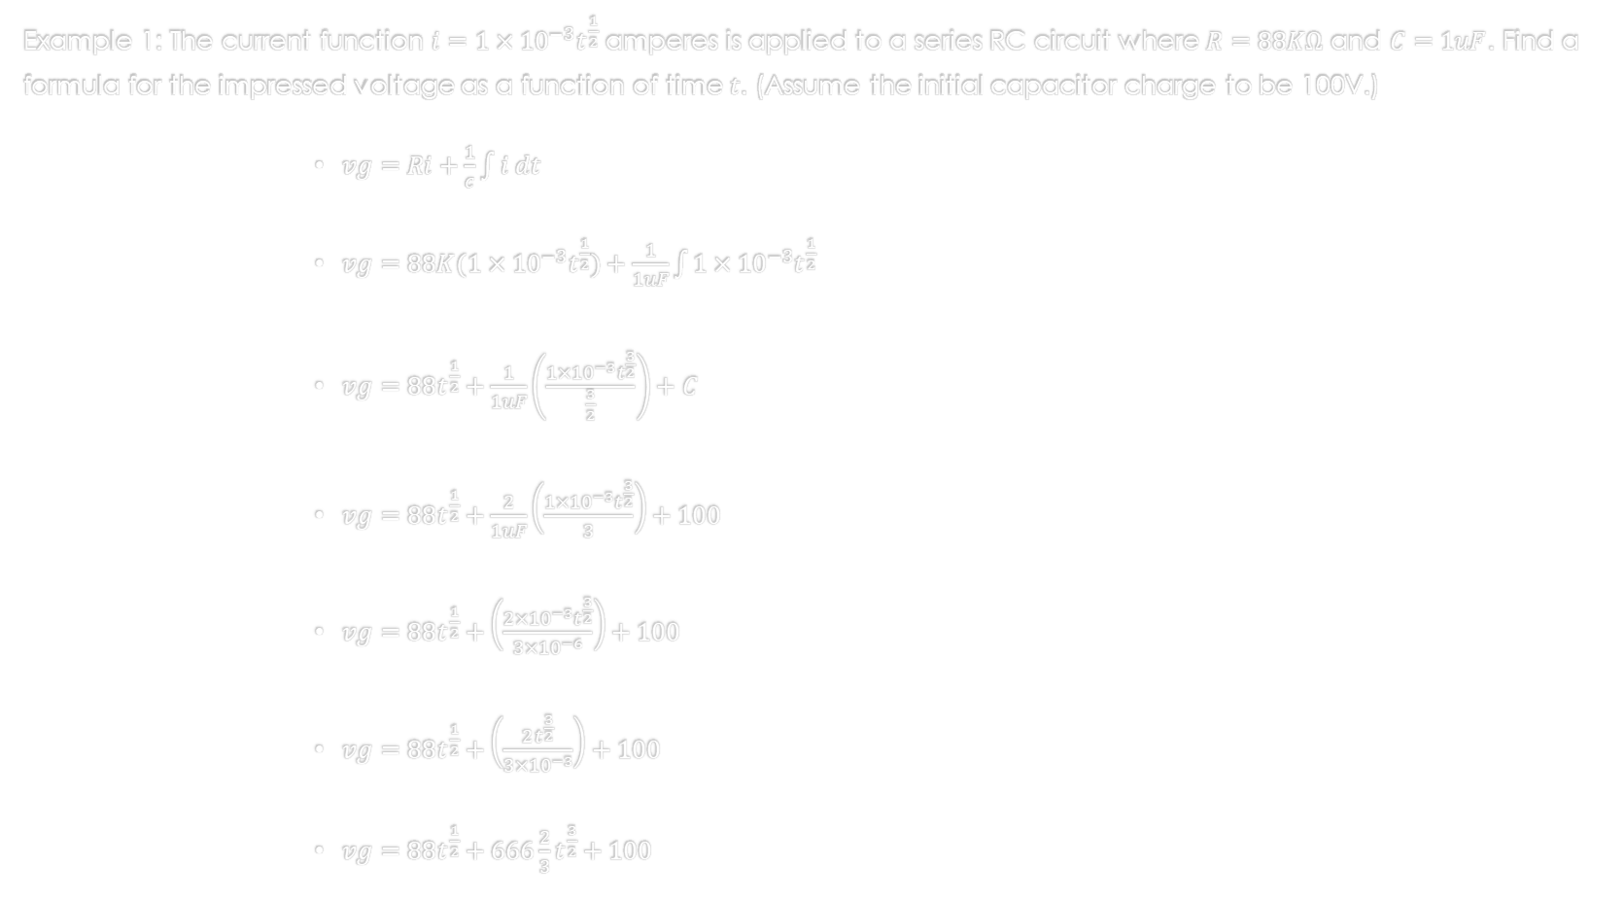
Integrals Applied Electronics Part 3
Example 1: The current function $i={1×10}^{−3}t^{\frac{1}{2}}$ amperes is applied to a series RC circuit where $R=88KΩ$ and $C=1uF$. Find a formula for the impressed voltage as a function of time $t$. (Assume the initial capacitor charge to be 100V.)
$vg=Ri+\frac{1}{c}\int{i dt}$
$vg=88K({1×10}^{−3}t^{\frac{1}{2}})+\frac{1}{1uF}\int{{1×10}^{−3}t^{\frac{1}{2}}}$
$vg=88t^{\frac{1}{2}}+\frac{1}{1uF}\left(\frac{{1×10}^{−3}t^{\frac{3}{2}}}{\frac{3}{2}}\right)+C$
$vg=88t^{\frac{1}{2}}+\frac{2}{1uF}\left(\frac{{1×10}^{−3}t^{\frac{3}{2}}}{3}\right)+100$
$vg=88t^{\frac{1}{2}}+\left(\frac{{2×10}^{−3}t^{\frac{3}{2}}}{3{×10}^{−6}}\right)+100$
$vg=88t^{\frac{1}{2}}+\left(\frac{2t^{\frac{3}{2}}}{3{×10}^{−3}}\right)+100$
$vg=88t^{\frac{1}{2}}+666\frac{2}{3}t^{\frac{3}{2}}+100$

Slide 3

Integrals Applied Electronics Part 3
Example 2: A series circuit where $L=0.1$henry and $C=100uF$has applied to it a current $i=0.1$ amps from $t=0$onward. Find (a) the formula for the voltage across the circuit and (b) the rate of change of the voltage at $t = 2 sec⁡$. (assume $Vc = 0$when $t=0$.
$vg=Ri+L\frac{di}{dt}+\frac{1}{C}\int{i dt}$
$vg=0+0.1\frac{di}{dt}+\frac{1}{100uF}\int{0.1 dt}$
$i=0.1$
$\frac{di}{dt}=0$
$vg=0+0+\frac{1}{100uF}(0.1t)$
$vg=1000t$
$\frac{dv}{dt}=1000v/s$

Slide 4
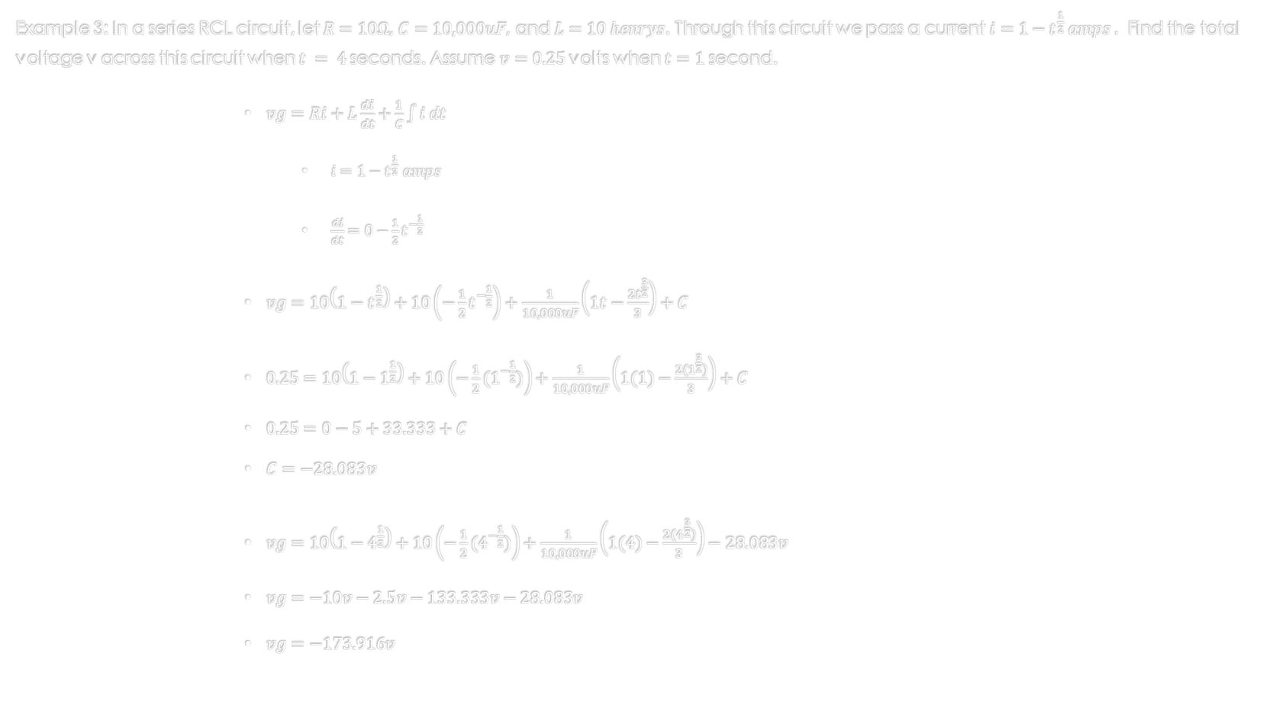
Integrals Applied Electronics Part 3
Example 3: In a series RCL circuit, let $R=10Ω$, $C=10,000uF$, and $L=10 henrys$. Through this circuit we pass a current $i=1−t^{\frac{1}{2}} amps .$ Find the total voltage v across this circuit when $t = 4$seconds. Assume $v=0.25$volts when $t=1$ second.
$vg=Ri+L\frac{di}{dt}+\frac{1}{C}\int{i dt}$
$i=1−t^{\frac{1}{2}} amps$
$\frac{di}{dt}=0−\frac{1}{2}t^{−\frac{1}{2}}$
$vg=10\left(1−t^{\frac{1}{2}}\right)+10\left(−\frac{1}{2}t^{−\frac{1}{2}}\right)+\frac{1}{10,000uF}\left(1t−\frac{{2t}^{\frac{3}{2}}}{3}\right)+C$
$0.25=10\left(1−1^{\frac{1}{2}}\right)+10\left(−\frac{1}{2}{(1}^{−\frac{1}{2}})\right)+\frac{1}{10,000uF}\left(1(1)−\frac{{2(1}^{\frac{3}{2}})}{3}\right)+C$
$0.25=0−5+33.333+C$
$C=−28.083v$
$vg=10\left(1−4^{\frac{1}{2}}\right)+10\left(−\frac{1}{2}(4^{−\frac{1}{2}})\right)+\frac{1}{10,000uF}\left(1(4)−\frac{{2(4}^{\frac{3}{2}})}{3}\right)−28.083v$
$vg=−10v−2.5v−133.333v−28.083v$
$vg=−173.916v$

Slide 5
References:
Ewen, D., Gary, J. S., & Trefzger, J. E. (2005). Technical calculus. Upper Saddle River, NJ: Pearson/Prentice Hall.
Richmond, A. E., & Hecht, G. W. (1995). Calculus for electronics. New York: Glence.

